Slide 1
Improved UI/UX
Right Click menu becomes pencil button & settings (category are here)
Description included in the action panel – remove management panel
New Design of Report Options
New Design of Workspace – buttons moved to top for central control

Slide 2
New Features
Enforce password change
Top menu included ”Help” to directly access knowledge base and submit support tickets
Enables share link – a report can be shared with anyone who has an account in Rangal
Color by in Report Option
Arrange tree nodes – Admin only

Slide 3
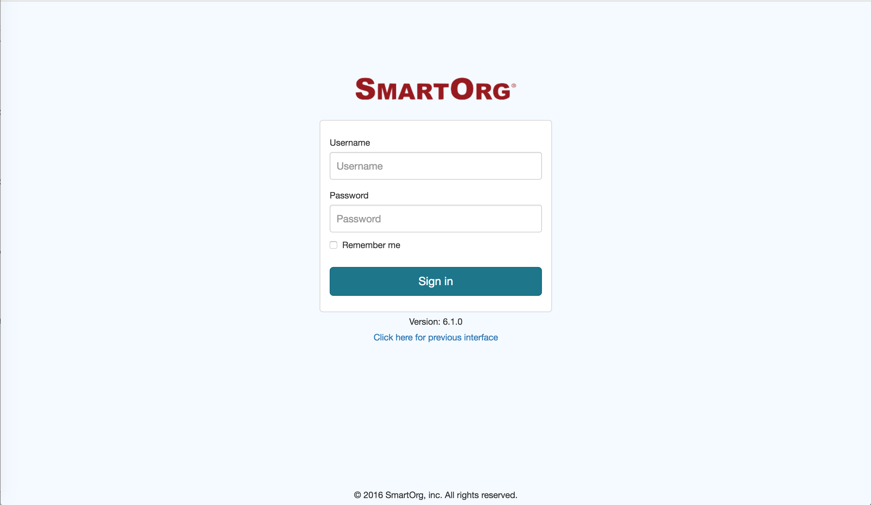
Notes:
First step, enter url and sign in

Slide 4
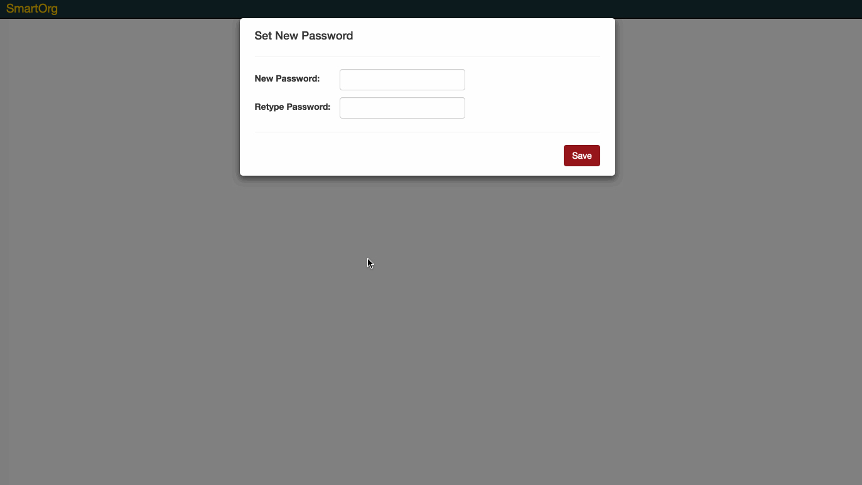
Notes:
1st time log into the system – enforce password change.

Slide 5
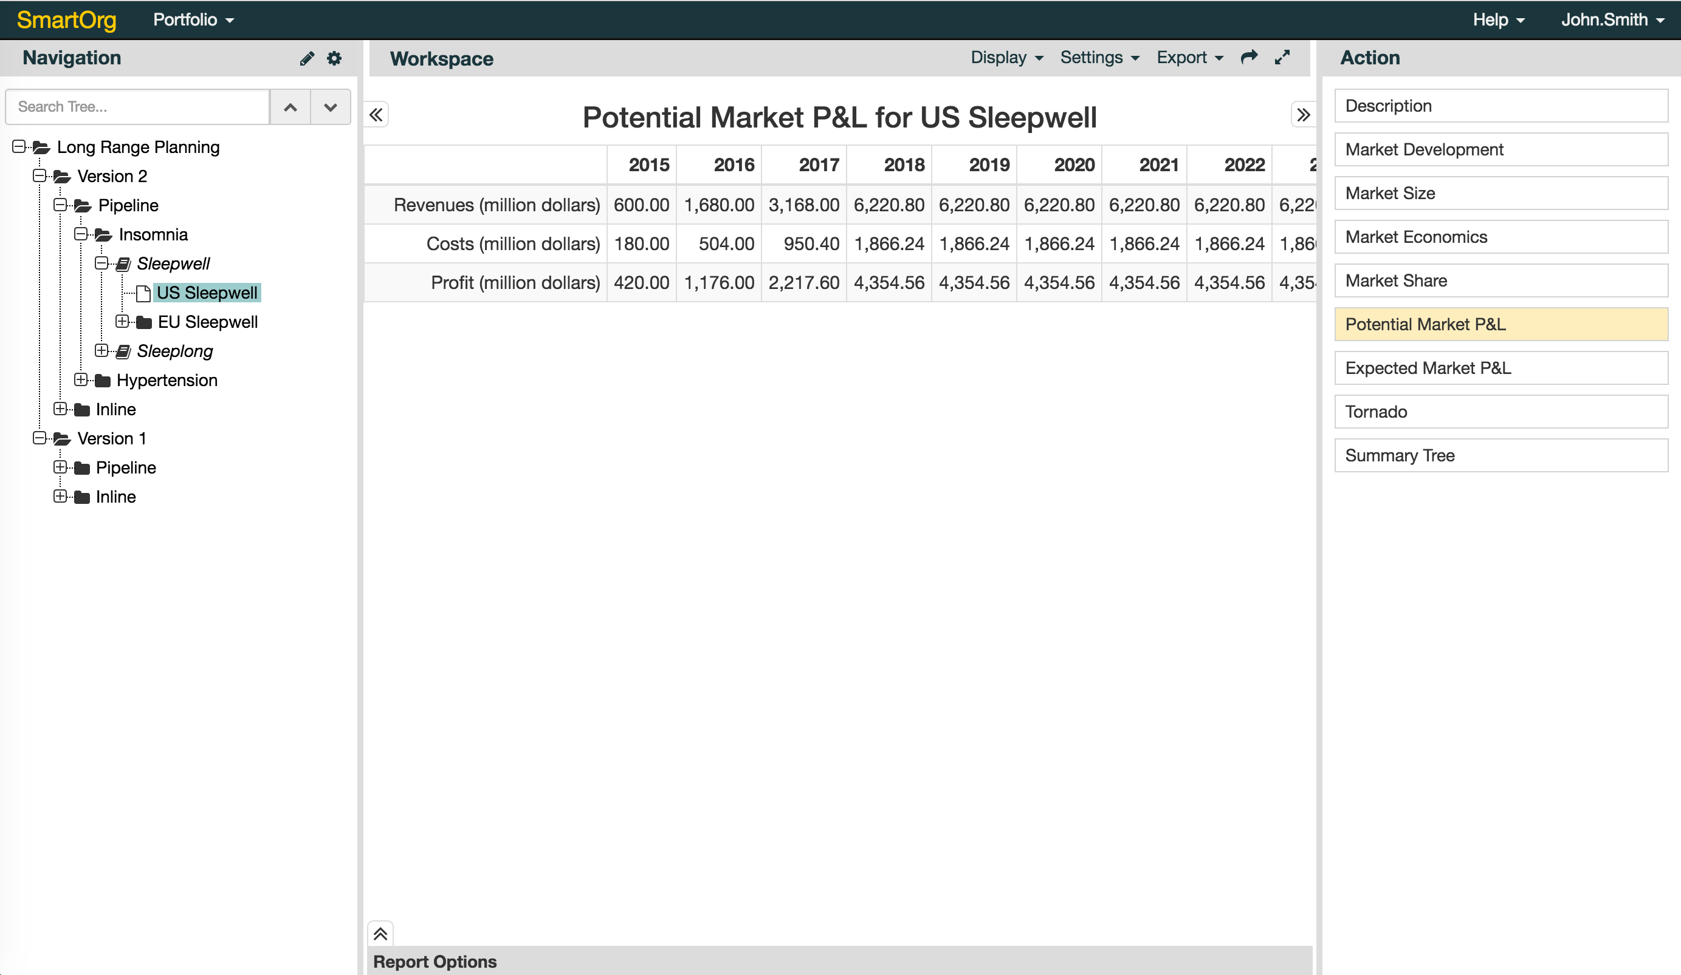
Notes:
Introducing top menu bar, navigation panel, action panel, report option, and workspace.

Slide 6
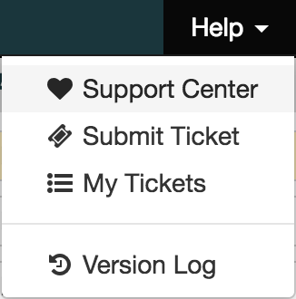
Notes:
Top Menu bar

Slide 7
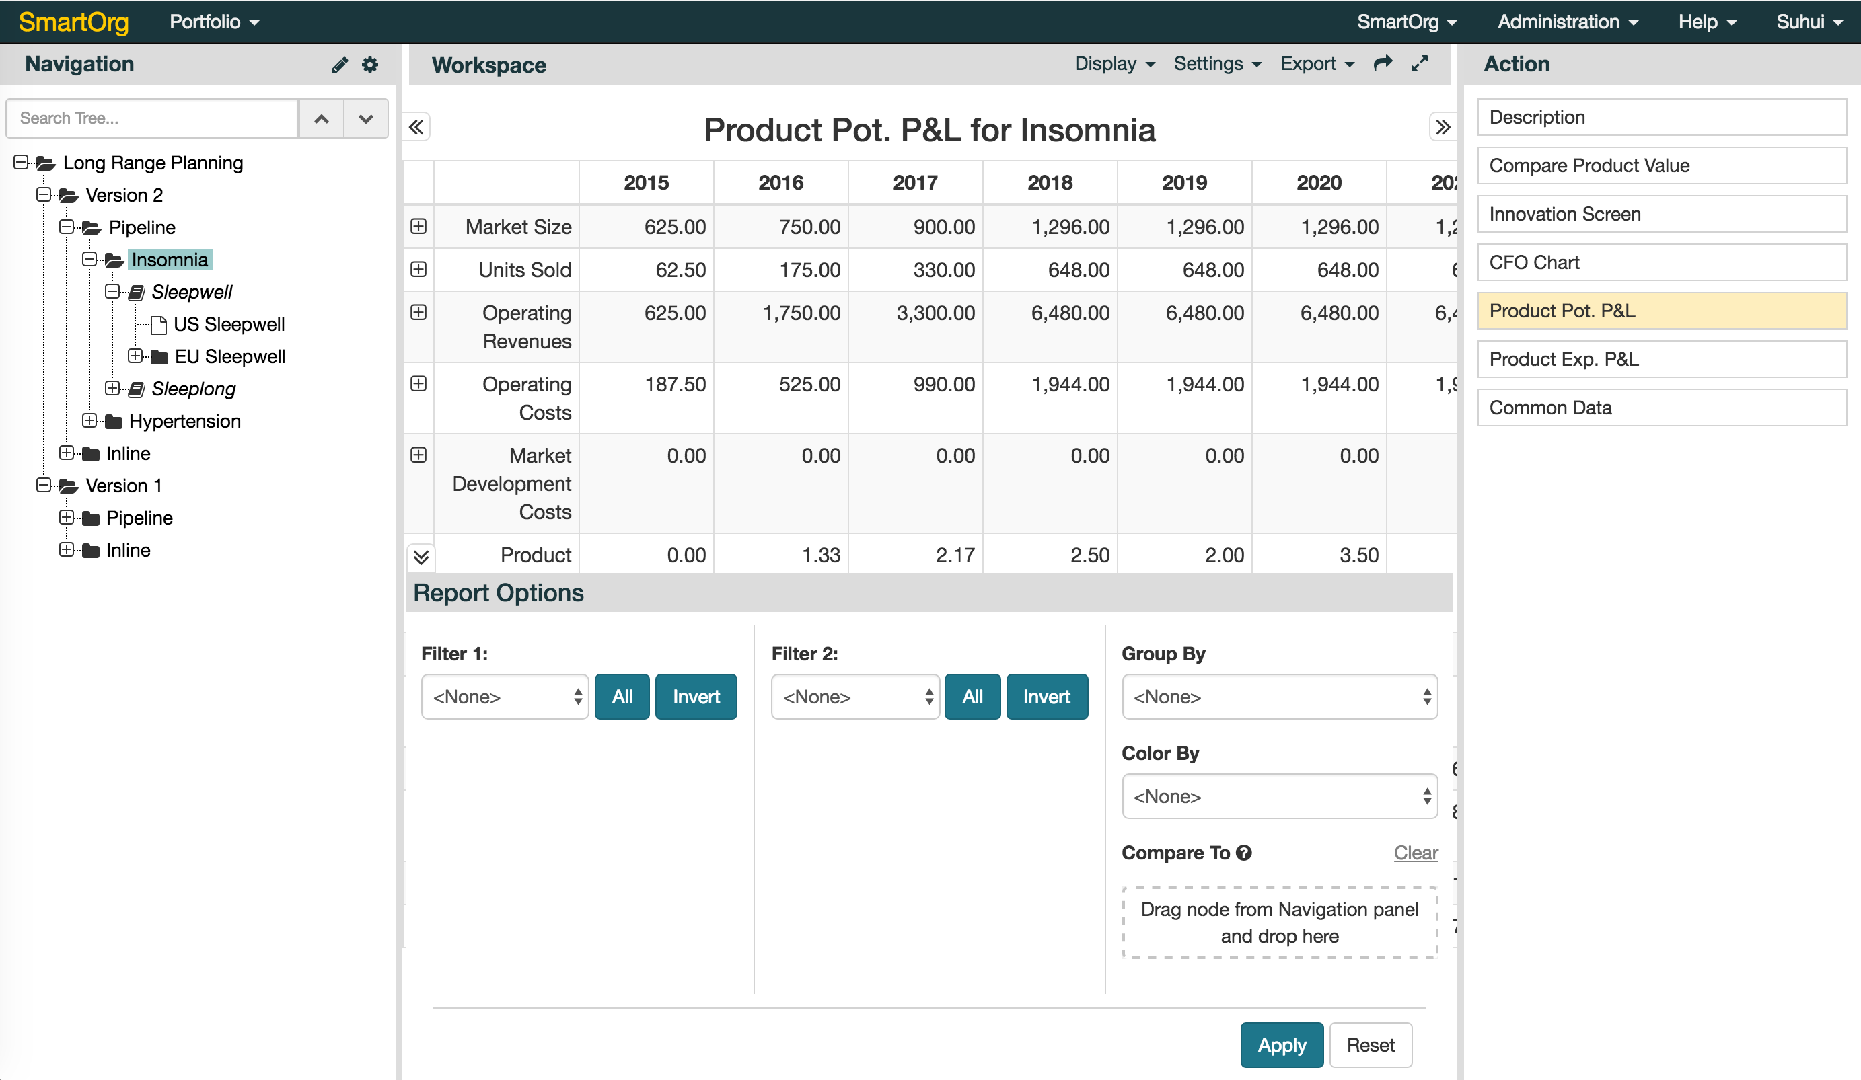
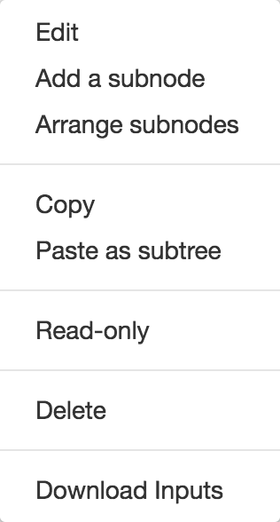
Notes:
Navigation Panel – added new feature: arrange subnodes. Reorganized the menus.

Slide 8
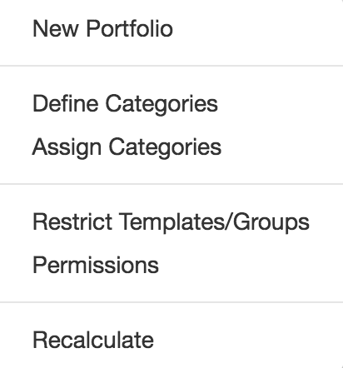
Notes:
Navigation Panel – Define Category & Assign Category moved from management panel to here.

Slide 9
Notes:
Action Panel – description always on the top: appearing first.

Slide 10
Notes:
Workspace – moves the buttons on the bottom to the menu bar in workbench. Added new feature – share with other people & maximize

Slide 11
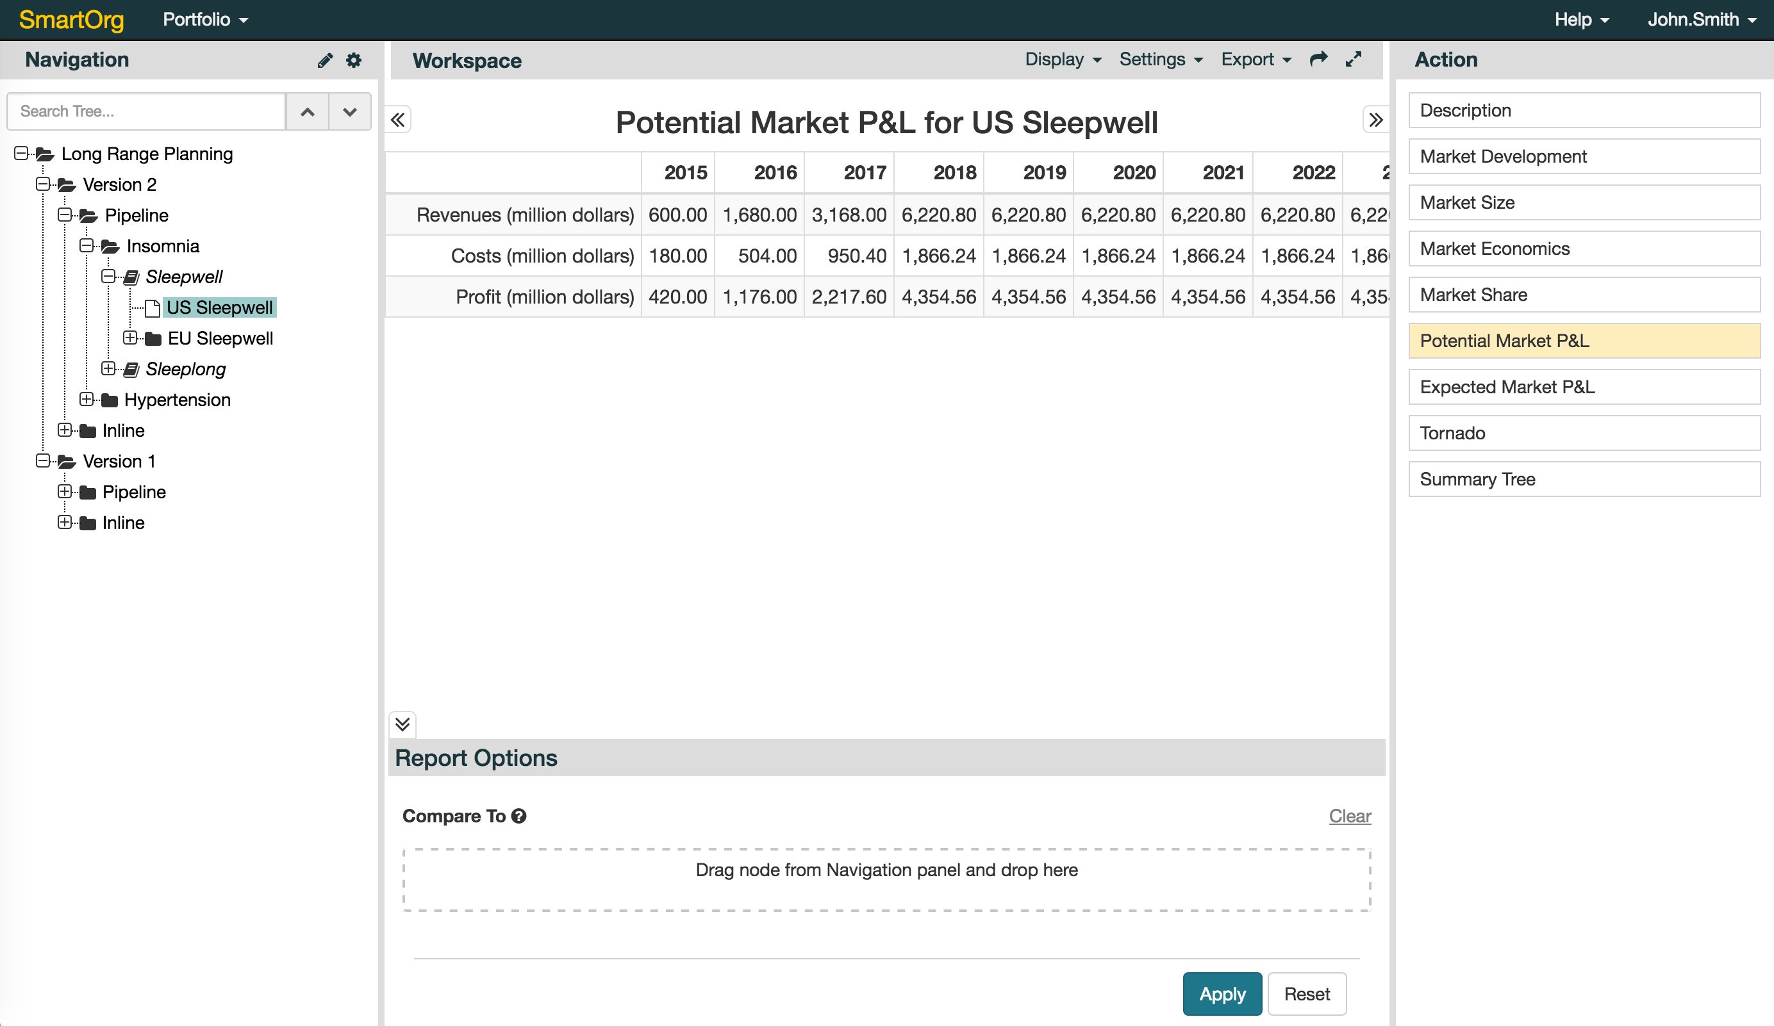
Notes:
Report Option – compare to using drag & drop

Slide 12
Notes:
Report Option at Parent level – added new feature: color by

Slide 13
Improved UX for admin
Address book & Group management

Slide 14
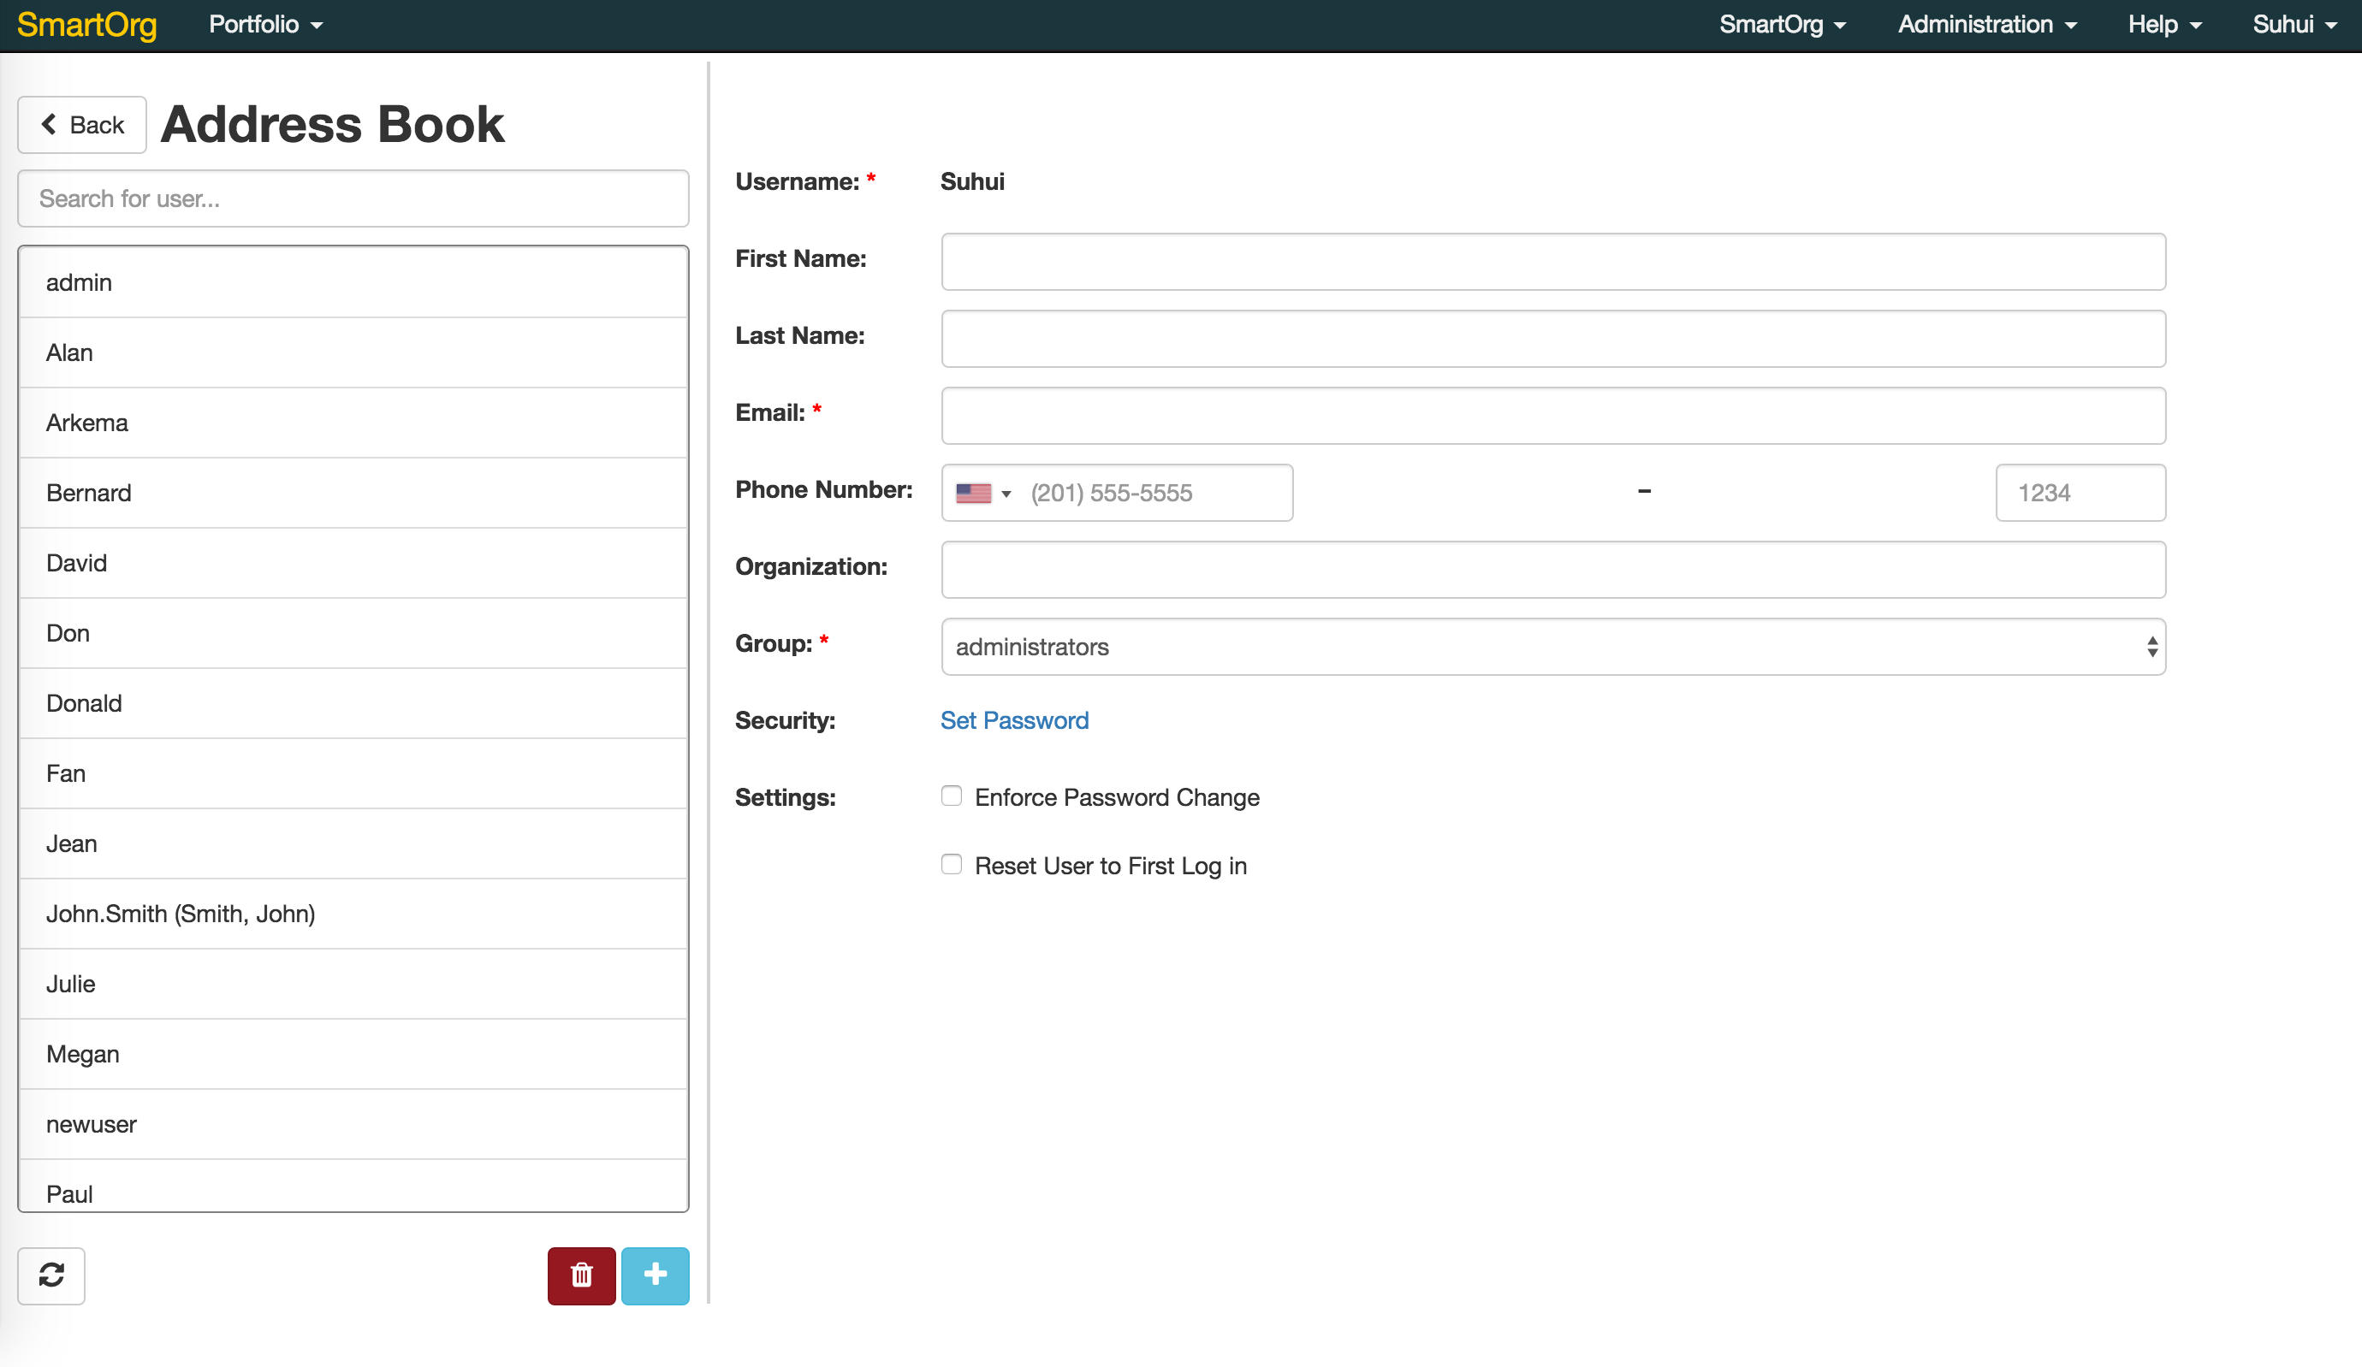
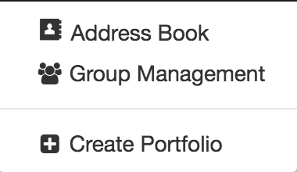
Notes:
System should all be able to create users and request them to change password.

Slide 15
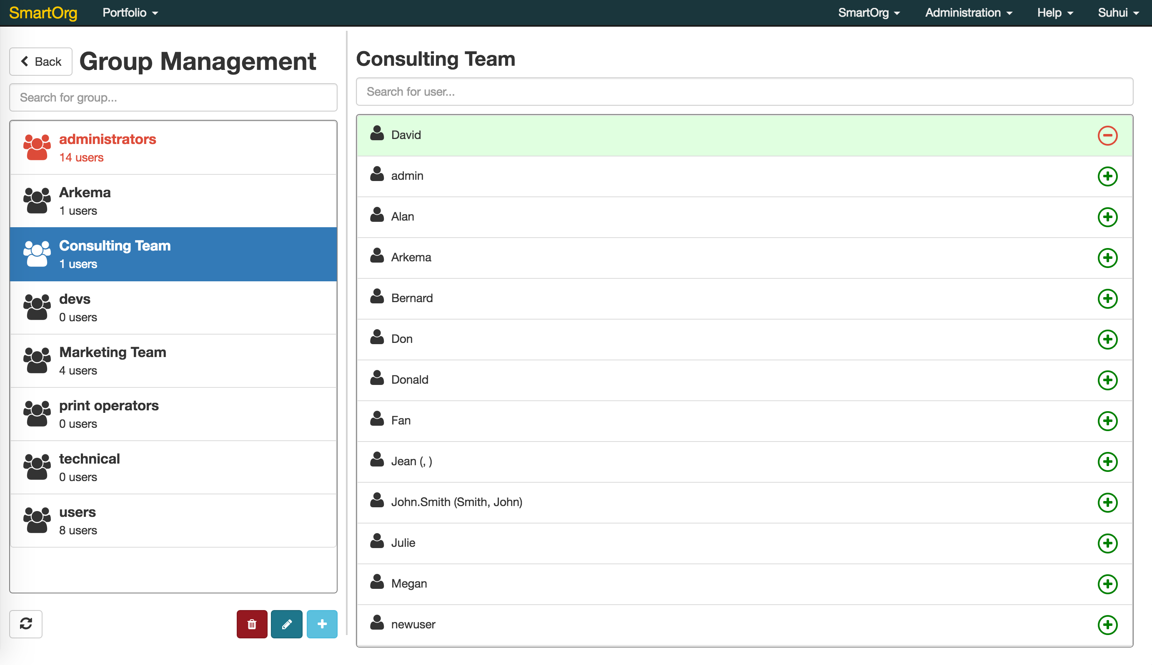

Slide 17
Notes:
Introducing top menu bar, navigation panel, action panel, report option, and workspace.

